Slide 1
Deep Learning for Biology
Joris Roels

Slide 2
Generative Neural Networks

Slide 3
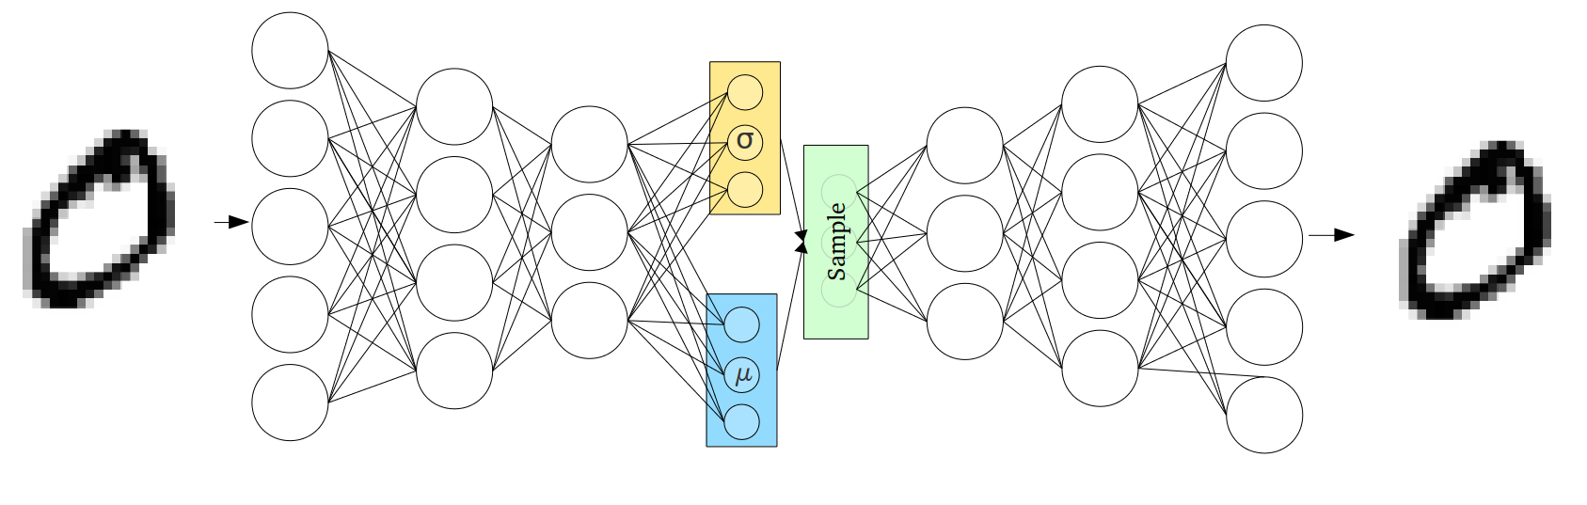

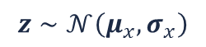
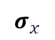
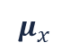
Overview
$$μ_{x}$$
Introduction
Variational Autoencoders
Generative Adversarial Networks
Applications of GANs
$$z∼𝒩\left(μ_{x},σ_{x}\right)$$
$$σ_{x}$$

Slide 4
Introduction

Slide 5
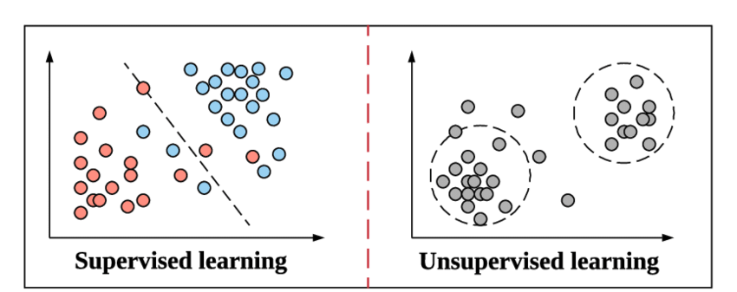
Introduction
Most machine learning applications focus on discriminative modelling:
Classification
Regression
Clustering
In this section, we will focus on generative models

Slide 6
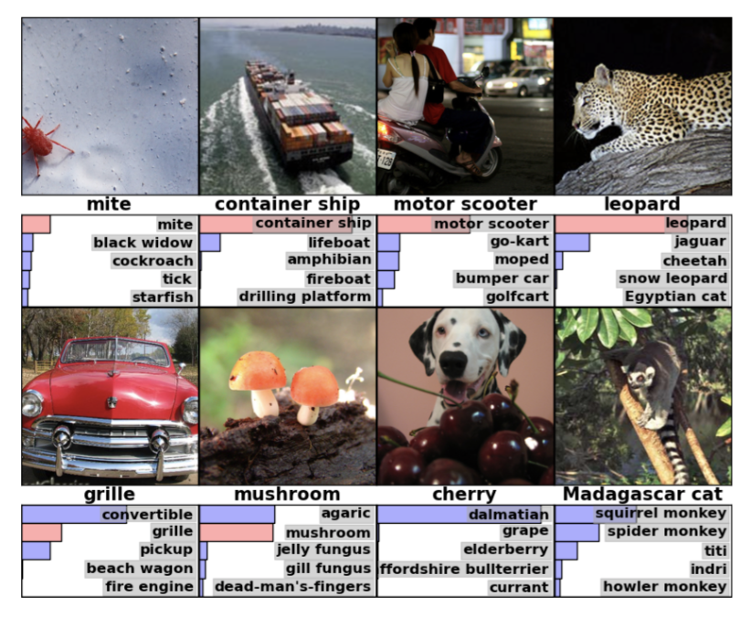
Introduction
Discriminative models:
Consider labeled data (class labels or cluster labels)
Images & object labels
Protein sequences & secondary structure
Single-cell data & cell types
Find a model that can predict these labels
Discriminate between (discrete or continuous) classes or clusters
Generative models:
Consider unlabeled data
Only images
Only protein sequences
Only single-cell data
Find a model that can generate similar data

Slide 7
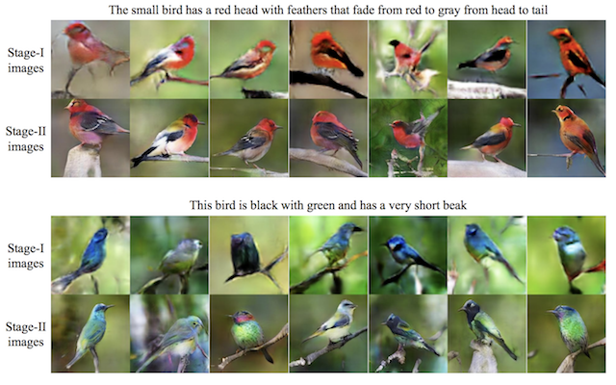
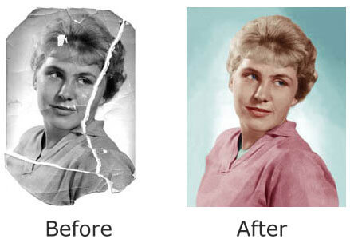
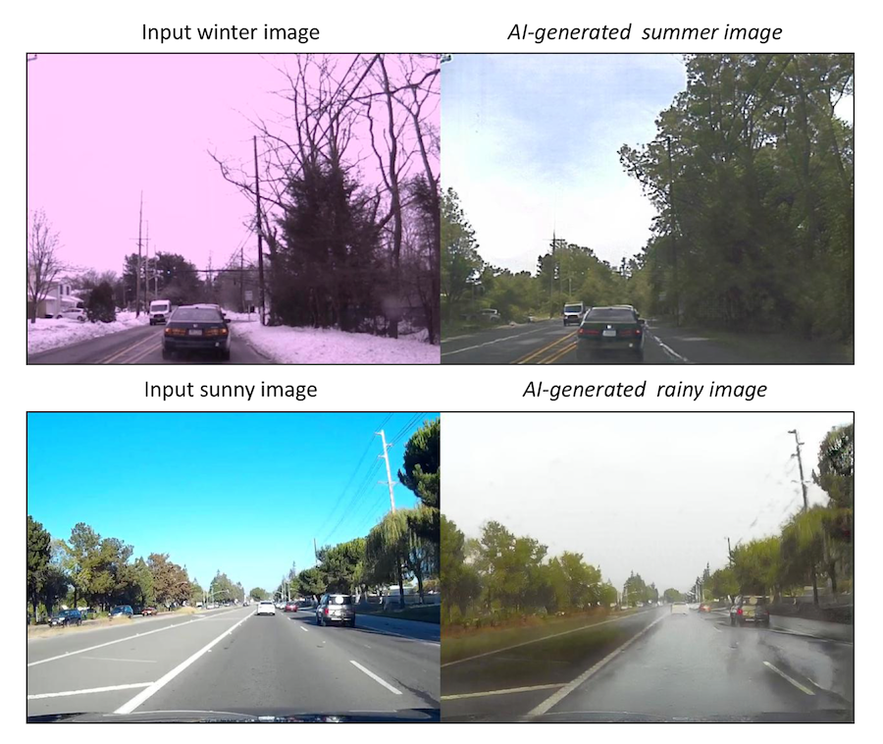
Introduction
Why would we bother generating data?
Image-to-image translation
Image restoration
Text-to-image translation

Slide 8
Introduction
Generative models:
Variational Autoencoder (VAE)
Generative Adversarial Networks (GAN)

Slide 9
Variational Autoencoders

Slide 10
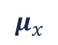
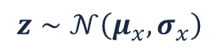
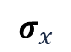
Variational autoencoder (VAE)
A VAE (Kingma et.al., 2014) is a special type of autoencoder:
Aims to reconstruct the input
Low-dimensional representation is not a value, but a distribution
Forward propagation requires sampling from this distribution (reparameterization)
$$μ_{x}$$
$$z∼𝒩\left(μ_{x},σ_{x}\right)$$
$$σ_{x}$$

Slide 11


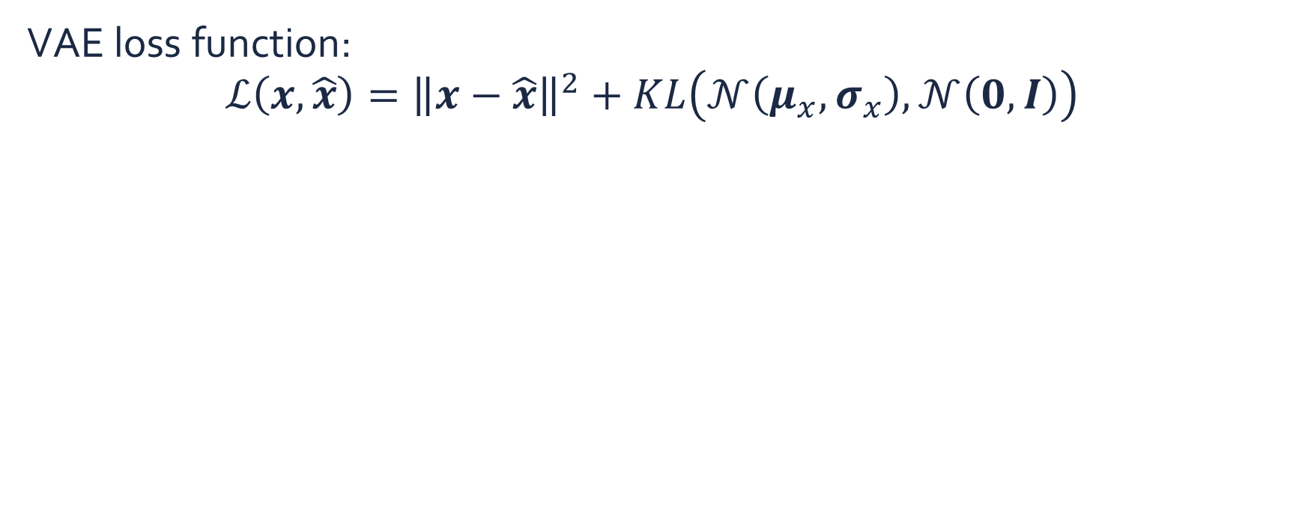
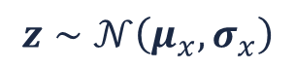
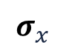
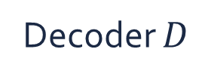
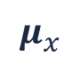

Variational autoencoder
VAE loss function:
$$ℒ\left(x,\hat{x}\right)={\left\|x−\hat{x}\right\|}^{2}+KL\left(𝒩\left(μ_{x},σ_{x}\right),𝒩\left(0,I\right)\right)$$
$$μ_{x}$$
Encoder $E$
Decoder $D$
$$z∼𝒩\left(μ_{x},σ_{x}\right)$$
$$x$$
$$σ_{x}$$
$$\hat{x}$$

Slide 12
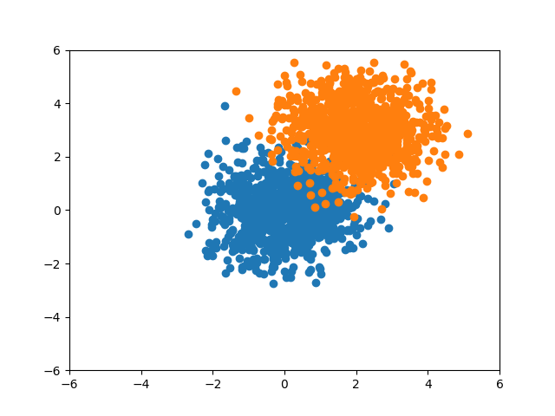
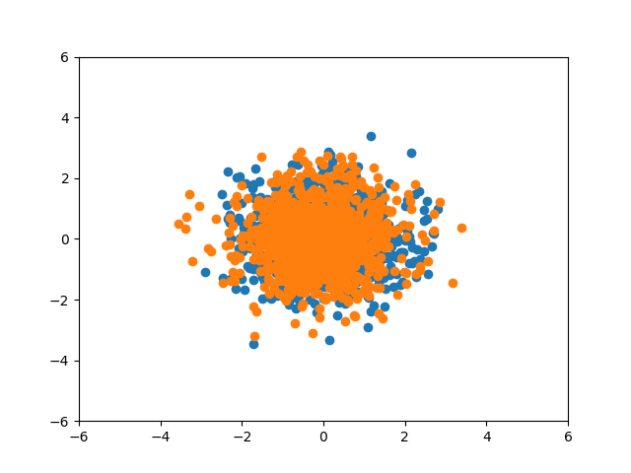
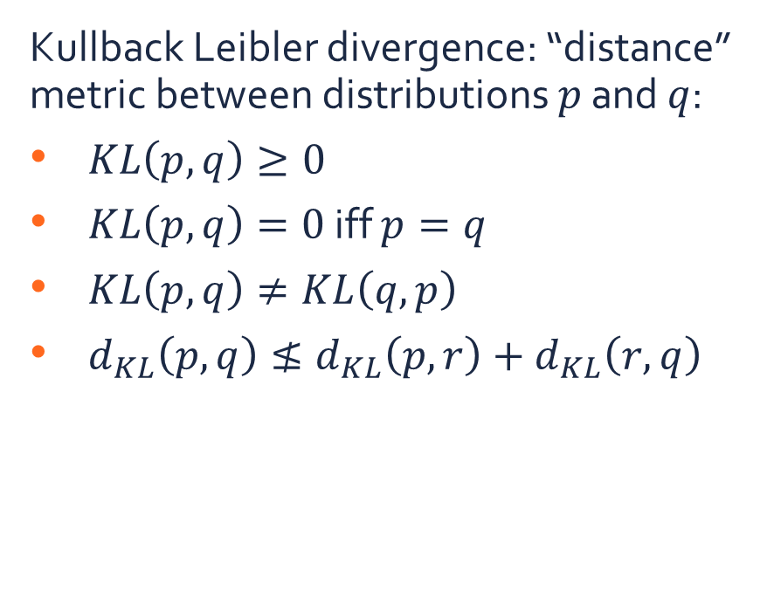
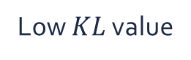
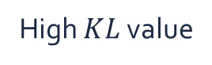
Variational autoencoder
Kullback Leibler divergence: “distance” metric between distributions $p$ and $q$:
$KL\left(p,q\right)≥0$
$KL\left(p,q\right)=0$ iff $p=q$
$KL\left(p,q\right)≠KL\left(q,p\right)$
$d_{KL}\left(p,q\right)≰d_{KL}\left(p,r\right)+d_{KL}\left(r,q\right)$
High $KL$ value
Low $KL$ value

Slide 13
Variational autoencoder
VAE loss function:
$$ℒ\left(x,\hat{x}\right)={\left\|x−\hat{x}\right\|}^{2}+KL\left(𝒩\left(μ_{x},σ_{x}\right),𝒩\left(0,I\right)\right)$$
Aims to reconstruct the data
Aims to map the latent distribution to a Gaussian
$$μ_{x}$$
$$z∼𝒩\left(μ_{x},σ_{x}\right)$$
$$x$$
$$σ_{x}$$
$$\hat{x}$$

Slide 14
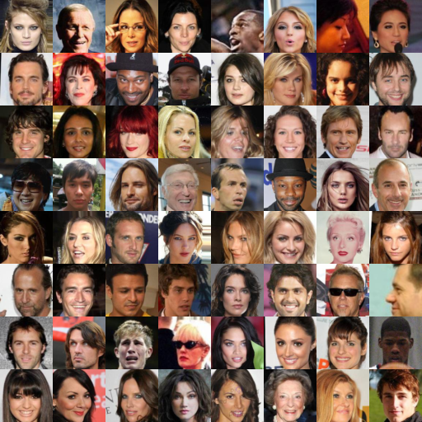
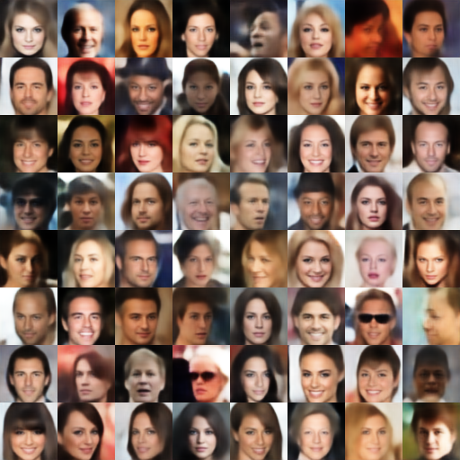
Variational autoencoder
Sample reconstruction
CelebA dataset
Reconstructions

Slide 15
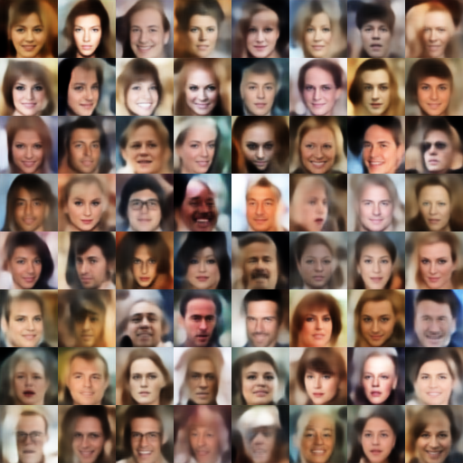
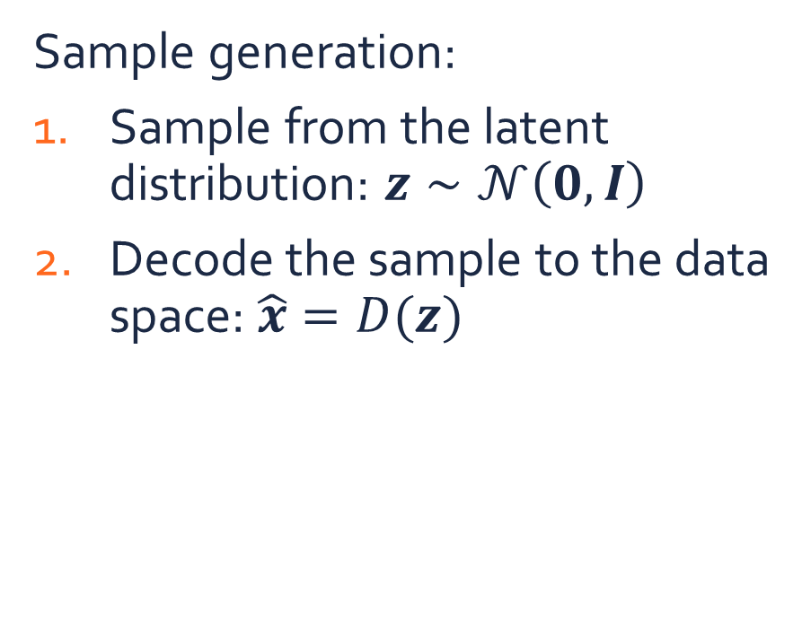

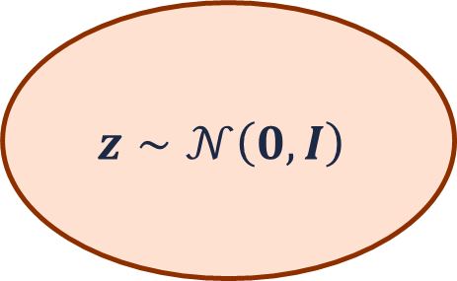
Variational autoencoder
Sample generation:
Sample from the latent distribution: $z∼𝒩\left(0,I\right)$
Decode the sample to the data space: $\hat{x}=D(z)$
$$z∼𝒩\left(0,I\right)$$
Decoder
$$x$$

Slide 16
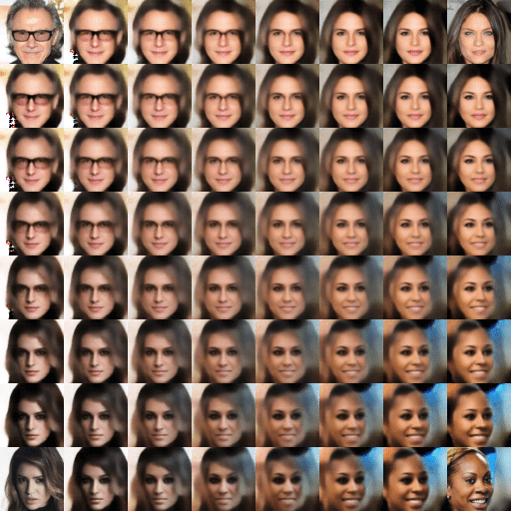


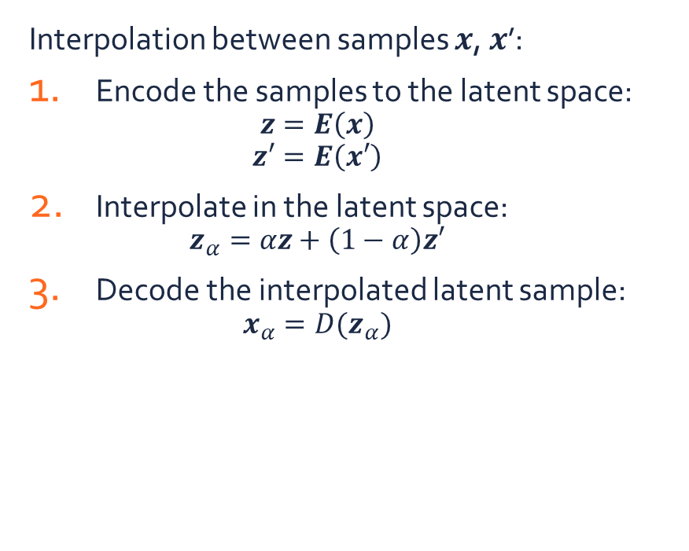
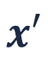

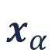
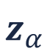
Variational autoencoder
Interpolation between samples $x$, $x$’:
Encode the samples to the latent space:
$$z=E\left(x\right)$$
$$z′=E\left(x′\right)$$
Interpolate in the latent space:
$$z_{α}=αz+\left(1−α\right)z′$$
Decode the interpolated latent sample:
$$x_{α}=D(z_{α})$$
Encoder
$$x$$
$$z$$
Decoder
$$z_{α}$$
$$x′$$
$$z′$$
$$x_{α}$$

Slide 17
Generative Adversarial Networks

Slide 18
Generative adversarial network (GAN)
Training:
Generator: tries to fool the discriminator
Discriminator: tries to classify as good as possible
A GAN (Goodfellow et.al., 2014) consists of two networks:
Generator: generates samples from random noise
Discriminator: discriminates between real training samples and generated samples

Slide 19
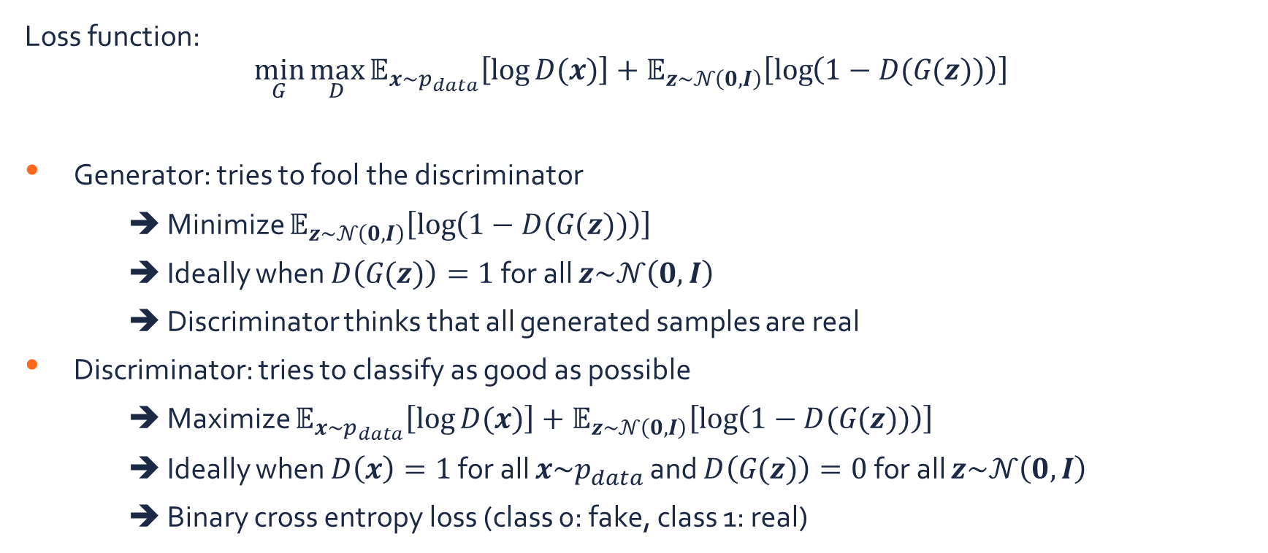
Generative adversarial network
Loss function:
$$\min_{G}{\max_{D}{𝔼_{x\sim p_{data}}\left[\log{D(x)}\right]+𝔼_{z\sim 𝒩\left(0,I\right)}\left[\log\left(1−D(G\text{(}z\text{)})\right)\right]}}$$
Generator: tries to fool the discriminator
➔ Minimize $𝔼_{z\sim 𝒩\left(0,I\right)}\left[\log\left(1−D(G\text{(}z\text{)})\right)\right]$
➔ Ideally when $D\left(G\text{(}z\text{)}\right)=1$ for all $z\sim 𝒩\left(0,I\right)$
➔ Discriminator thinks that all generated samples are real
Discriminator: tries to classify as good as possible
➔ Maximize $𝔼_{x\sim p_{data}}\left[\log{D(x)}\right]+𝔼_{z\sim 𝒩\left(0,I\right)}\left[\log\left(1−D(G\text{(}z\text{)})\right)\right]$
➔ Ideally when $D\left(x\right)=1$ for all $x\sim p_{data}$ and $D\left(G\text{(}z\text{)}\right)=0$ for all $z\sim 𝒩\left(0,I\right)$
➔ Binary cross entropy loss (class 0: fake, class 1: real)

Slide 20
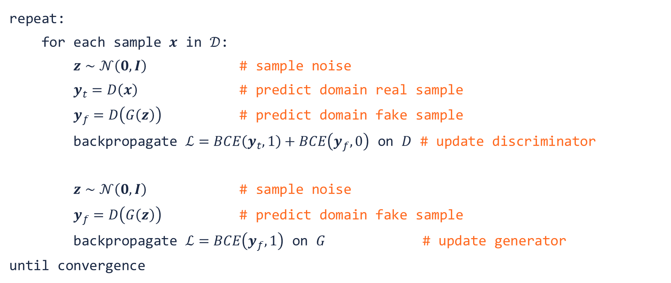
Generative adversarial network
repeat:
for each sample $x$ in $𝒟$:
$z∼𝒩\left(0,I\right)$ # sample noise
$y_{t}=D\left(x\right)$ # predict domain real sample
$y_{f}=D\left(G\left(z\right)\right)$ # predict domain fake sample
backpropagate $ℒ=BCE\left(y_{t},1\right)+BCE\left(y_{f},0\right)$ on $D$ # update discriminator
$z∼𝒩\left(0,I\right)$ # sample noise
$y_{f}=D\left(G\left(z\right)\right)$ # predict domain fake sample
backpropagate $ℒ=BCE\left(y_{f},1\right)$ on $G$ # update generator
until convergence
Train discriminator
Train generator

Slide 21
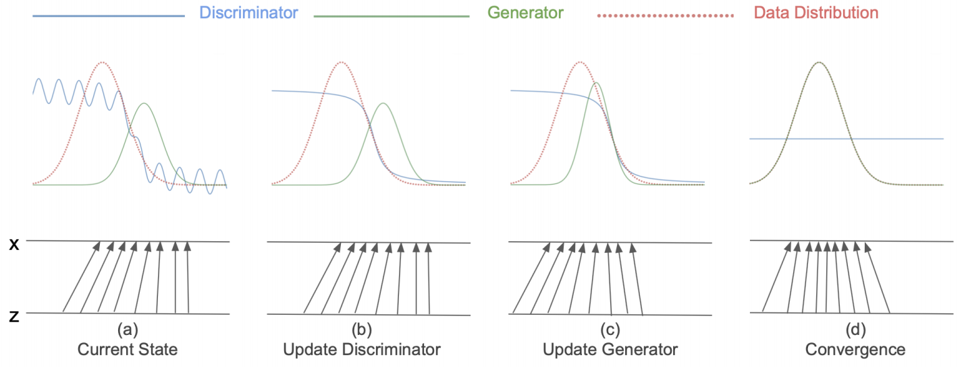
Generative adversarial network
Training: iteratively update discriminator & generator

Slide 22
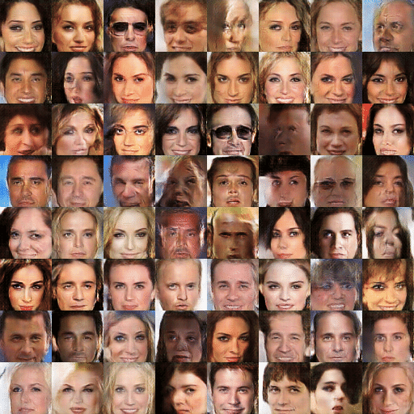
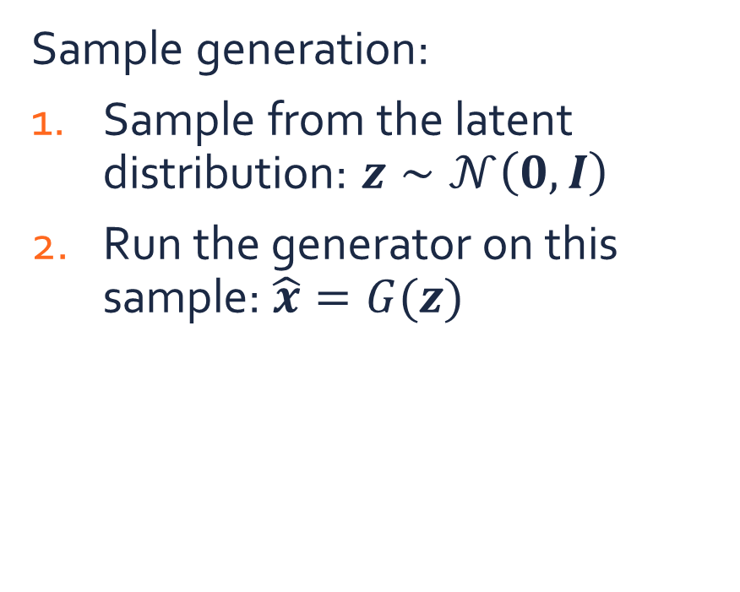
Generative adversarial network
Sample generation:
Sample from the latent distribution: $z∼𝒩\left(0,I\right)$
Run the generator on this sample: $\hat{x}=G(z)$

Slide 23
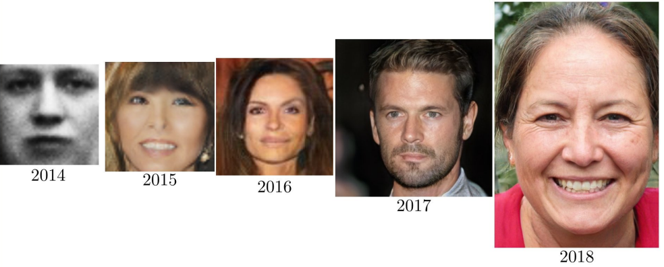
Generative adversarial network
There has been lots of research on GANs for the last years
Goodfellow et.al., 2014
Radford et.al., 2015
Liu et.al., 2016
Karras et.al., 2018
Karras et.al., 2019

Slide 24
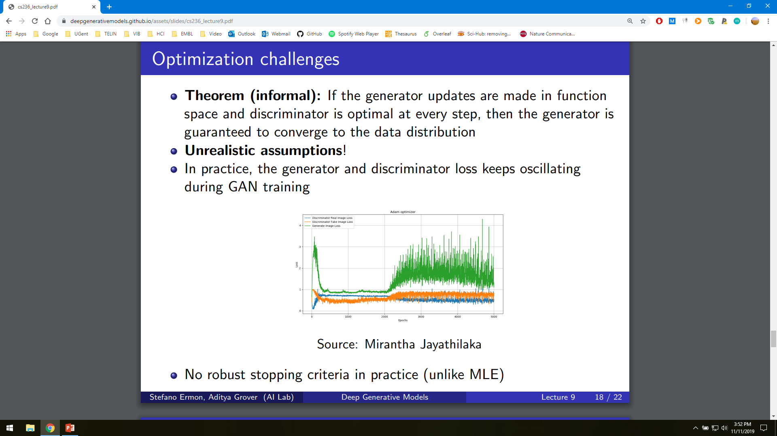
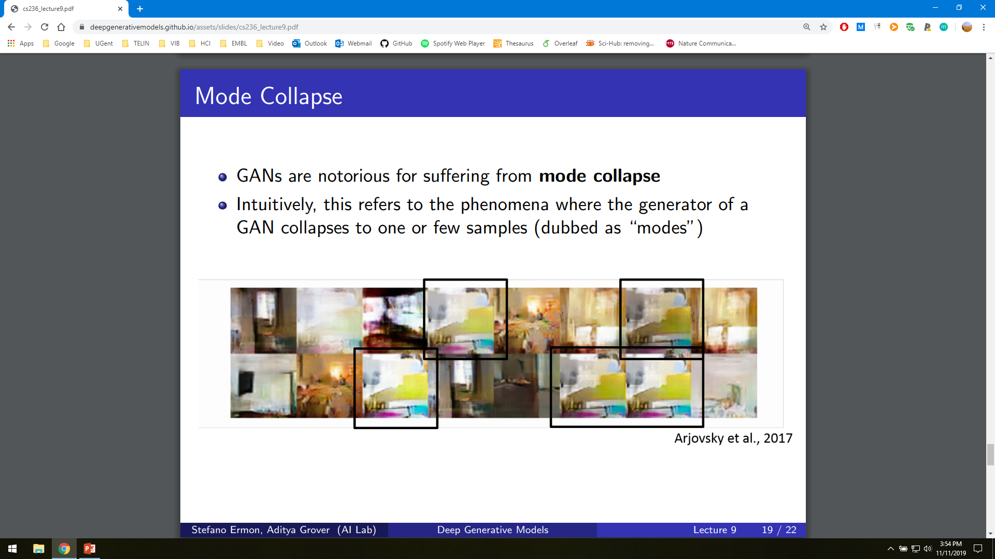
Generative adversarial network
Lots of challenges remain in GAN research:
Unstable optimization
Mode collapse
Evaluation
Arjovsky et.al., 2017

Slide 25
Applications of GANs

Slide 26
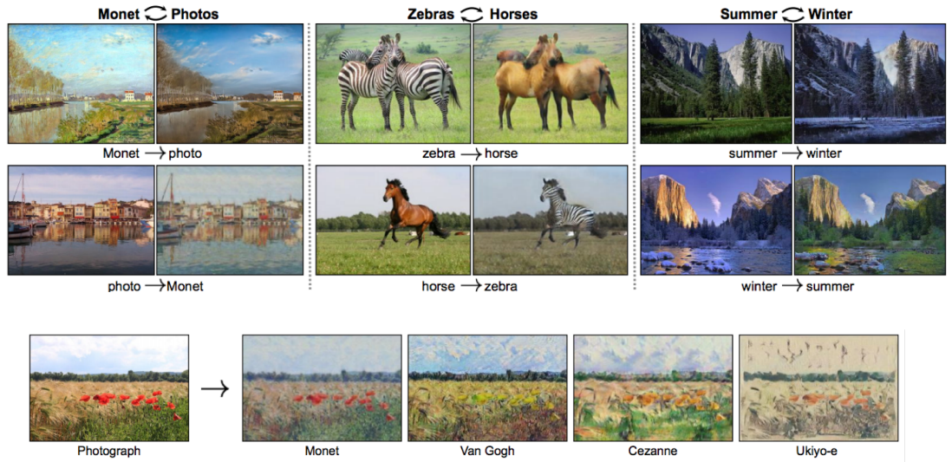
Image-to-image translation
Zhu et.al., 2017

Slide 27
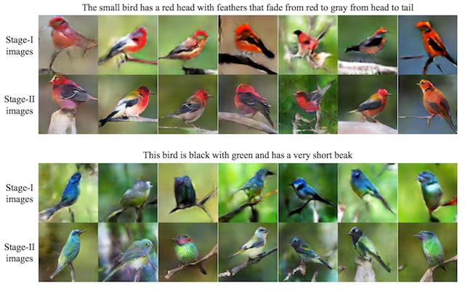
Text-to-image translation
Zhang et.al., 2017

Slide 28
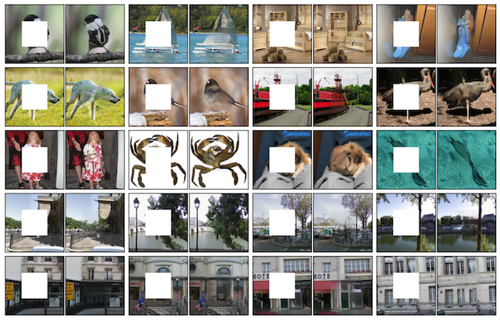
Photo inpainting
Pathak et.al., 2016

Slide 29

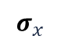

Summary
$$μ_{x}$$
Generative models vs discriminative models
Variational autoencoders
Latent representation = distribution
Kullback Leibler regularization
Realistic sample generation & interpolation
Generative adversarial networks
Adversarial game
Generator
Discriminator
The current state-of-the-art in generative modelling
Applications
$$z∼𝒩\left(μ_{x},σ_{x}\right)$$
$$σ_{x}$$

Slide 30
Exercises

Slide 31
Exercises
Open the notebook in Google Colab:
https://colab.research.google.com/github/JorisRoels/deep-learning-biology/blob/main/exercises/assignments/2020-dlb-6-generative-neural-networks.ipynb
Make sure you are using a GPU: Runtime > Change Runtime Type > Select ‘GPU’
Move to your break-out room
Try to solve the exercises
After every exercise we will come back to the main room and discuss the results
The complete solution notebook will be uploaded at the end of the session
Ask questions to the assistants in the break-out room!

Slide 33
References
Kingma, D. P., & Welling, M. (2014). Auto-Encoding Variational Bayes. International Conference on Learning Representations.
Goodfellow, I., Pouget-Abadie, J., Mirza, M., Xu, B., Warde-Farley, D., Ozair, S., Courville, A., & Bengio, Y. (2014). Generative Adversarial Nets. Neural Information Processing Systems, 2672–2680. https://doi.org/10.1017/CBO9781139058452
Radford, A., Metz, L., & Chintala, S. (2015). Unsupervised Representation Learning with Deep Convolutional Generative Adversarial Networks. International Conference on Learning Representations. http://arxiv.org/abs/1511.06434
Liu, M.-Y., & Tuzel, O. (2016). Coupled generative adversarial networks. Neural Information Processing Systems.
Karras, T., Aila, T., Laine, S., & Lehtinen, J. (2018). Progressive growing of GANs for improved quality, stability, and variation. International Conference on Learning and Representations.
Karras, T., Laine, S., & Aila, T. (2019). A style-based generator architecture for generative adversarial networks. IEEE Conference on Computer Vision and Pattern Recognition. https://doi.org/10.1109/CVPR.2019.00453
Arjovsky, M., Chintala, S., & Bottou, L. (2017). Wasserstein generative adversarial networks. International Conference on Machine Learning, 214–223. https://doi.org/10.2507/daaam.scibook.2010.27
Zhu, J. Y., Park, T., Isola, P., & Efros, A. A. (2017). Unpaired Image-to-Image Translation Using Cycle-Consistent Adversarial Networks. Proceedings of the IEEE International Conference on Computer Vision. https://doi.org/10.1109/ICCV.2017.244
Zhang, H., Xu, T., Li, H., Zhang, S., Wang, X., Huang, X., & Metaxas, D. (2017). StackGAN: Text to Photo-Realistic Image Synthesis with Stacked Generative Adversarial Networks. Proceedings of the IEEE International Conference on Computer Vision. https://doi.org/10.1109/ICCV.2017.629
Pathak, D., Krahenbuhl, P., Donahue, J., Darrell, T., & Efros, A. A. (2016). Context Encoders: Feature Learning by Inpainting. IEEE Conference on Computer Vision and Pattern Recognition. https://doi.org/10.1109/CVPR.2016.278

